Slide 1
PROGRAMMING AND PROBLEM SOLVING
ACTIVITY
TEAM MEMBERS :
1.Anitha
2.Bhuvaneshwari
3.Anu Sri
4.Harshini

Slide 2
QUESTION :
IMPLEMENTATION OF STACK USING ARRAY
A stack is a linear data structure in which the insertion of a new element and removal of an
existing element takes place at the same end represented as the top of the stack.
This strategy states that the element that is inserted last will come out first. You can take a
pile of plates kept on top of each other as a real-life example. The plate which we put last is
on the top and since we remove the plate that is at the top, we can say that the plate that was
put last comes out first

Slide 3
CODE :
#include<stdio.h>
int stack[100],choice,n,top,x,i;
int push(void);
int pop(void);
int display(void);
int main()
{
top=-1;
printf ("\n Enter the size of STACK[MAX=100]:");
scanf ("%d",&n);
printf ("\n\t STACK OPERATIONS USING ARRAY");
printf ("\n\t--------------------------------");
printf ("\n\t 1.PUSH\n\t 2.POP\n\t 3.DISPLAY\n\t 4.EXIT");

Slide 4
do
{
printf("\n Enter the Choice:");
scanf("%d",&choice);
switch(choice)
{
case 1:
{
push();
break;
}
case 2:
{
pop();
break;
}
case 3:
{
display();
break;
}
case 4:
{
printf("\n\t EXIT POINT ");
break;
}
default:
{
printf ("\n\t Please Enter a Valid Choice(1/2/3/4)");
}
}
}
while(choice!=4);
return 0;
}

Slide 5
int push()
{
if(top>=n-1)
{
printf("\n\tSTACK is over flow");
}
else
{
printf(" Enter a value to be pushed:");
scanf("%d",&x);
top++;
stack[top]=x;
}
}
int pop()
{
if(top<=-1)
{
printf("\n\t Stack is under flow");
}
else
{
printf("\n\t The popped elements is %d",stack[top]);
top--;
}
}

Slide 6
int display()
{
if(top>=0)
{
printf("\n The elements in STACK \n");
for(i=top; i>=0; i--)
printf("\n%d",stack[i]);
printf("\n Press Next Choice");
}
else
{
printf("\n The STACK is empty");
}
}

Slide 7
OUTPUT :
Enter the size of STACK[MAX=100]:10
STACK OPERATIONS USING ARRAY
--------------------------------
1.PUSH
2.POP
3.DISPLAY
4.EXIT
Enter the Choice:1
Enter a value to be pushed:23
Enter the Choice:1
Enter a value to be pushed:34
Enter the Choice:1
Enter a value to be pushed:56
Enter the Choice:3
The elements in STACK
56
34
23
Press Next Choice
Enter the Choice:2
The popped elements is 56
Enter the Choice:3
The elements in STACK
34
23
Press Next Choice
Enter the Choice:4
EXIT POINT

Slide 8
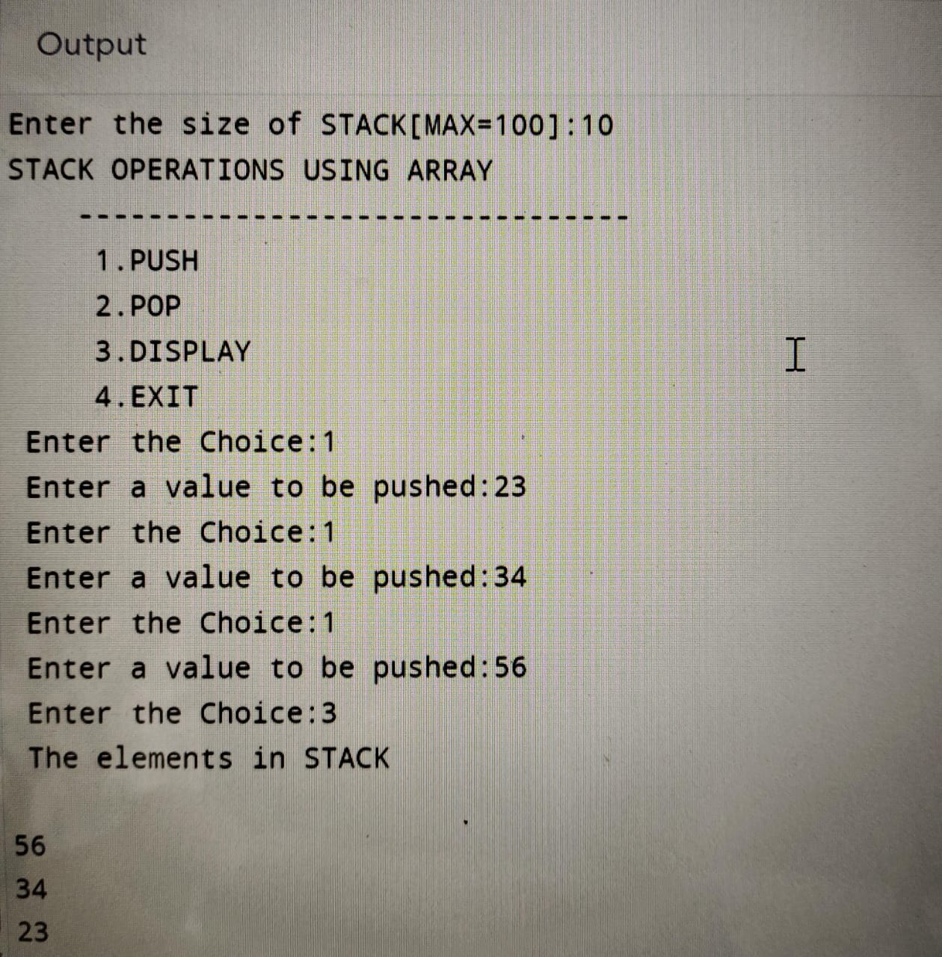
STACK : first come last out
last come first out

